Slide 1
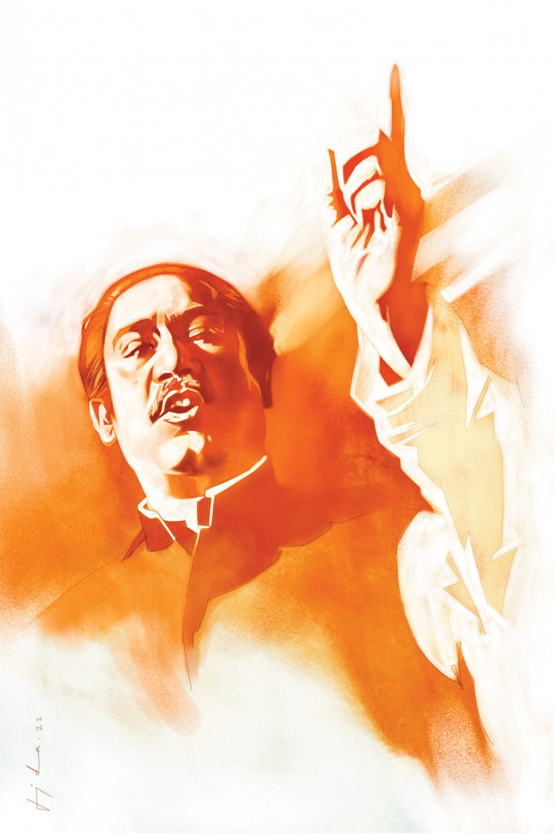
L
1948 - 1952
anguage
ovement
M
PRESENTED BY
SHEIKH SARAFAT HOSSAIN
(2022-3-60-109)

Slide 2
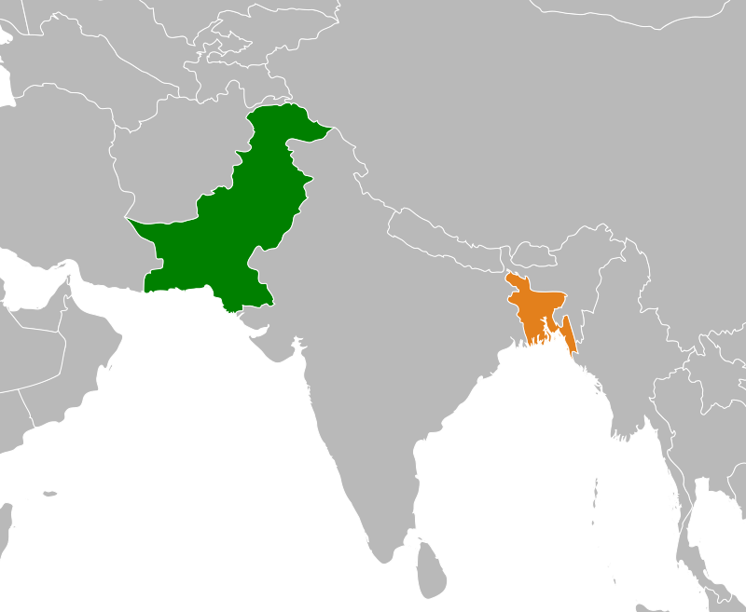
WHAT WOULD BE THE STATE LANGUAGE OF PAKISTAN?
The question was raised immediately after the creation of Pakistan.
The central leaders and the Urdu-speaking intellectuals of Pakistan declared that Urdu would be the state language of Pakistan.
The students and intellectuals of East Pakistan,started to raise their voice that Bangla be made one of the state languages which finally turned into a mass movement.

Slide 3

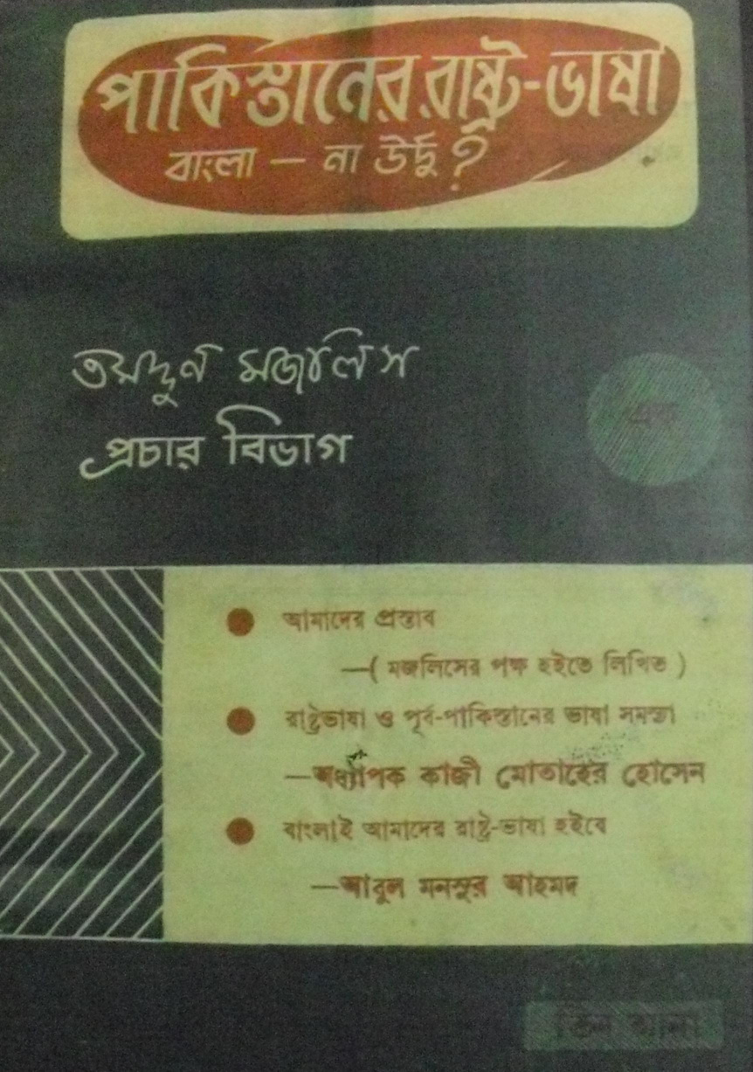
1947
The first movement on this issue was mobilised by Tamaddun Majlish headed by Professor Abul Kashem.With Students and Professors of Dhaka University this organization was founded on 2 September 1947.
The central education minister,Fazlur Rahman to make Urdu the only state language of Pakistan. On receipt of this information, East Pakistani students became agitated and held a meeting on the Dhaka University campus on 6 December 1947, demanding that Bangla be made one of the state languages of Pakistan.
The first Rastrabhasa Sangram Parishad (Language Action Committee) was formed towards the end of December with Professor Nurul Huq Bhuiyan of Tamaddun Majlish as the convener.

Slide 4
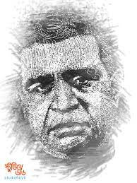
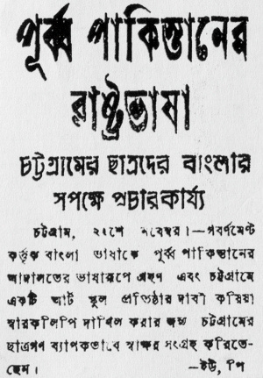
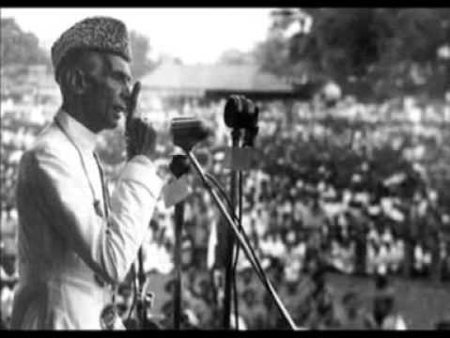
1948
Dhirendranath Datta, a member from the East Pakistan Congress Party, moved an amendment motion to include Bangla as one of the languages of the Constituent Assembly on 23 February 1948.
On 11 March 1948 a general strike was observed in the towns of East Pakistan in protest against the omission of Bangla from the languages of the Constituent Assembly.
Mohammad Toaha was severely injured while trying to snatch away a rifle from a policeman and had to be admitted to hospital. Strikes were observed from 12 March to 15 March.
Muhammad Ali Jinnah came to visit East Pakistan on 19 March. He addressed in two meetings where he ignored the popular demand for Bangla and repeated that Urdu would be the only state language of Pakistan. This declaration was instantly protested .

Slide 5


1952
On 27 January 1952, Khwaja Nazimuddin came to Paltan Maidan,Dhaka where he said that the people of the province could decide what would be the provincial language, but only Urdu would be the state language of Pakistan.
There was a negative reaction to this speech among the students who responded with the slogan, 'Rashtrabhasha Bangla Chai' (We want Bangla as the state language).
On 30 January,A strike was observed at Dhaka University where the Language Action Committee decided to call a hartal and organise demonstrations and processions on February 21 throughout East Pakistan.
the government-imposed Section 144 to ban all assemblies and demonstrations
The students were determined to violate Section 144 and held a student meeting at 11.00 am on 21 February
Unable to control the agitated students, the police fired upon the crowd of students.

Slide 6


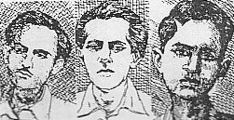
Consequence
Three young men, Rafiq Uddin Ahmed, Abdul Jabbar and Abul Barkat were fatally wounded. Abdus Salam and a nine-year-old boy named Ohiullah was also killed. Many injured persons were admitted to the hospital.
Recognisition made on the constitution that “The state language of Pakistan shall be Urdu and Pakistan
The next day, 22 February The public performed a janaza (prayer service for the dead) and brought out a mourning procession,
On 23 February, at the spot where students had been killed, a memorial was erected.

Slide 7


Significance
21st February is decided to commemorate Shahid dibosh to remember the supreme struggle of the martyrs
In 1963, the temporary structure was replaced by a concrete memorial, the Shaheed Minar (martyrs' memorial)
17 November 1999, the UNESCO General Convenience recognized 21st february as International Mother Language Day every year.
The movement laid a major foundation of our liberation war.

